Slide 1
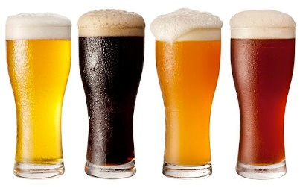
This Photo by Unknown Author is licensed under CC BY-SA
Unit 8 Project
EDA By: Hao Wang and Alex Salamah

Slide 2

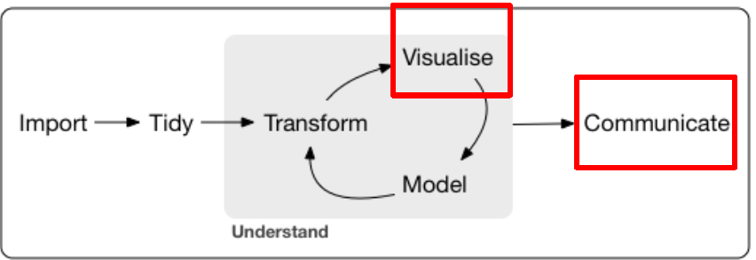
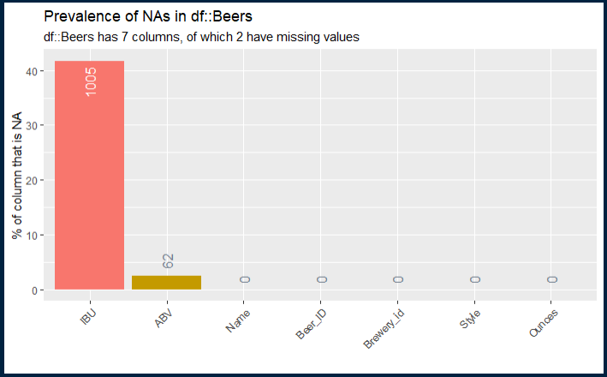
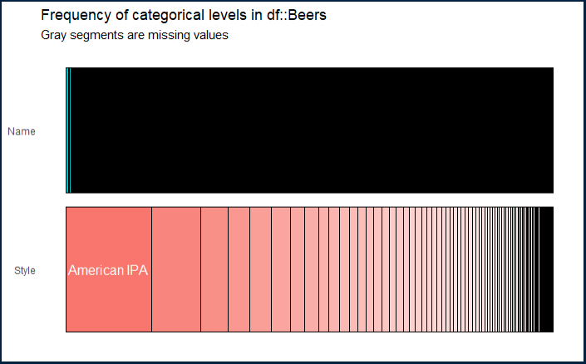
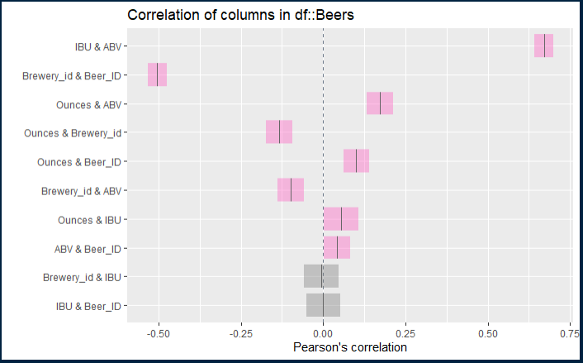
INITIAL DATA PROFILING BEERS DATA SET
Beers data set: 2410 observations, 7 variables.
2 factors: Name & Style
3 integers: Beer ID, IBU & Brewery ID
2 numeric: ABV & Ounces
Missing Values:
IBU: 1005 observations (42%)
ABV: 62 observations (3%)
Unique Values:
Beer Name: 2305 unique values and 105 duplicates.
Beer Style: 100 unique values
Categories: The most prevalent category in the style dimension is “American IPA” (Fig. 2)
Figure 1 Missing Values Analysis
Figure 2 Categorical Analysis
Figure 3 Coloration Analysis
Notes:
Substantial number of observation is missing from the IBU attribute 1005 almost 42%
Initial correlation analysis indicate between IBU and ABV also between Ounces and ABV.

Slide 3

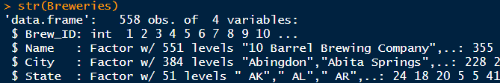
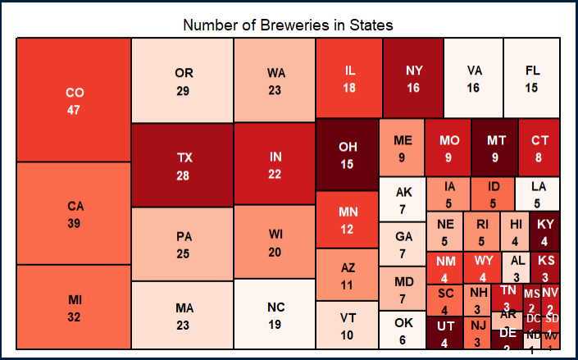
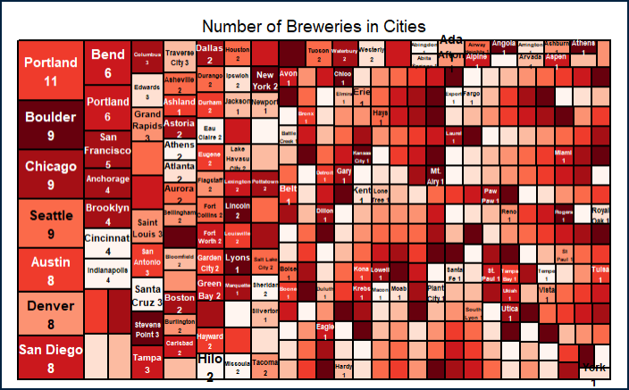
INITIAL DATA PROFILING BREWERIES DATA SET
The raw Breweries data set consists of 558 observations and four variables (Fig. 1):
Three Factors: Name, City & State
One Integer: Brewery ID
Missing Values: None
Unique Values: The Breweries are all uniquely identified and are spread out across 384 cities in 51 states. Colorado has the largest number of breweries (47) Followed by California (39) and Michigan (32) in 3rd place. (Fig. 2)
Portland leads the cities with 11 Breweries
Figure 1Brewries Data Set Profile
Figure 2 Breweries Count By State
Figure 3 Breweries Count By City
Notes:
Question 1

Slide 4
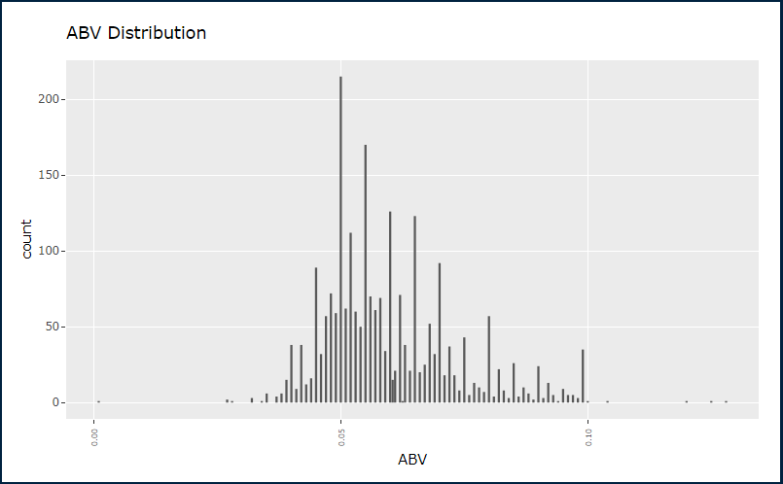
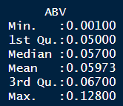
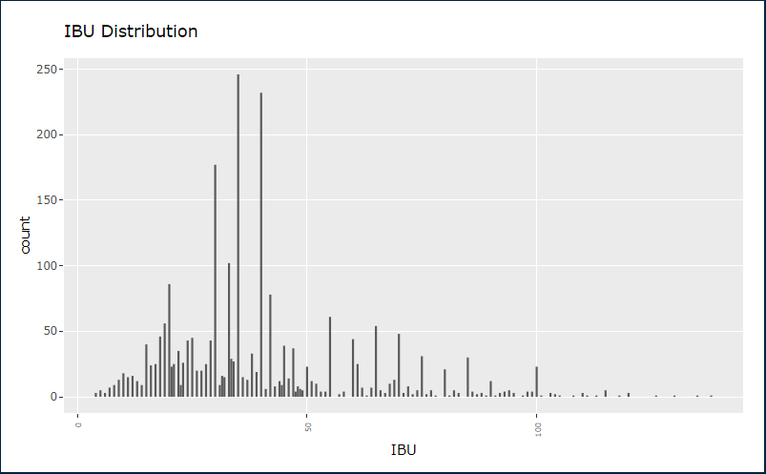
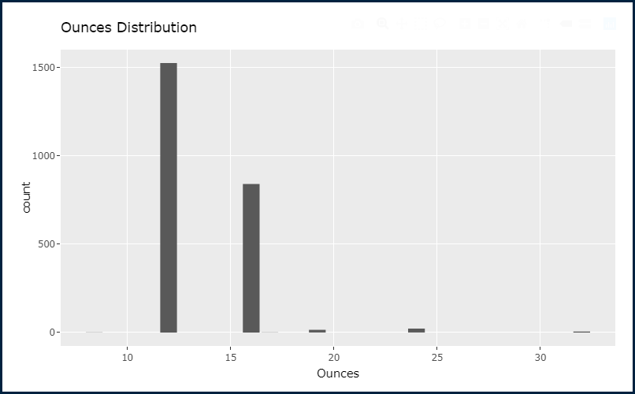
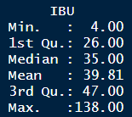
EDA – ABV & IBU distribution Merged Breweries and Beers DF
The Alcohol By Volume (ABV) distribution appears to be normal with a mean at 0.059 and a median at 0.057. (Fig. 1)
The International Bitterness Units (IBU) is also relatively normally distributed with a median of 35 and a mean of 39.81. (Fig 2)
Both variables appear to have some outliers
Figure 1 ABV distribution post cleanup
Figure 2 IBU Distribution post Cleanup
Figure 3 Can size distribution
Notes:
After removing missing values

Slide 5
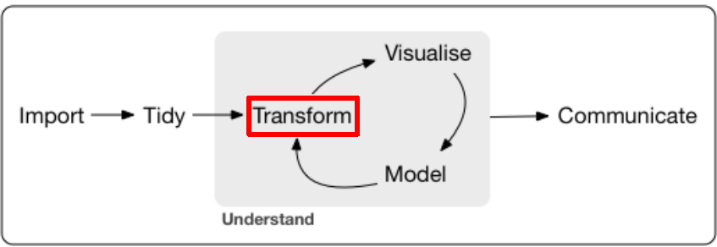
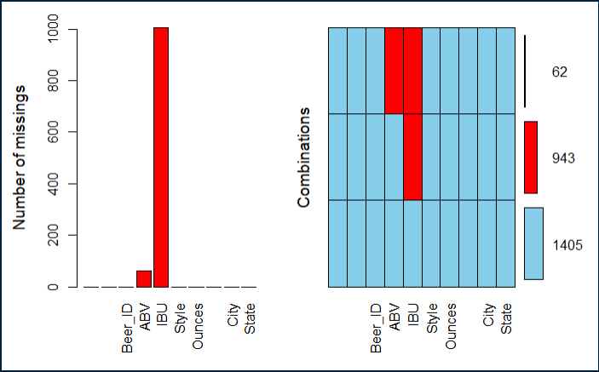
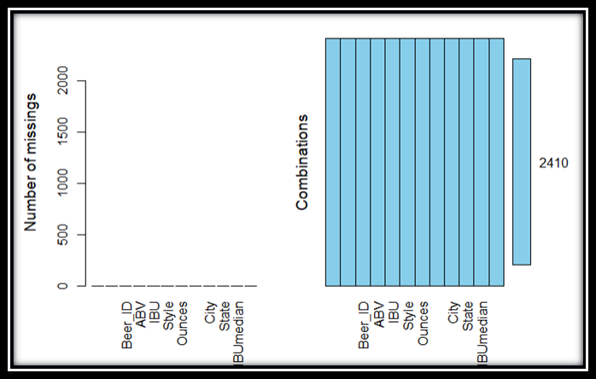
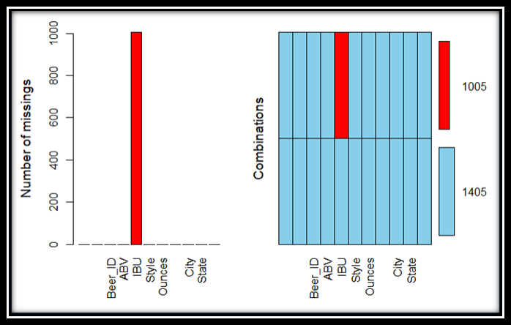
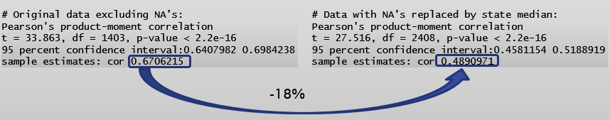
DATA Transformation MISSING VALUES IN MERGED DF
Identifying Missing values:
There 62 observations where both ABV and IBU are NA’s
943 observations where the IBU only are NA’s (Fig. 1)
Dealing with missing values:
Replace 62 NA’s in ABV with state level median (Fig. 2)
Replacing 1005 NA’s with state level median led to an 18% reduction in the accuracy of the correlation model (Fig. 3) Using predicted values from simple linear regression model improved the accuracy of the model
Figure 1 ABV & IBU missing values
Figure 3 All NA’s removed
Figure 2 Missing ABV removed
Figure 4
Notes:
Q3 Address the missing values

Slide 6
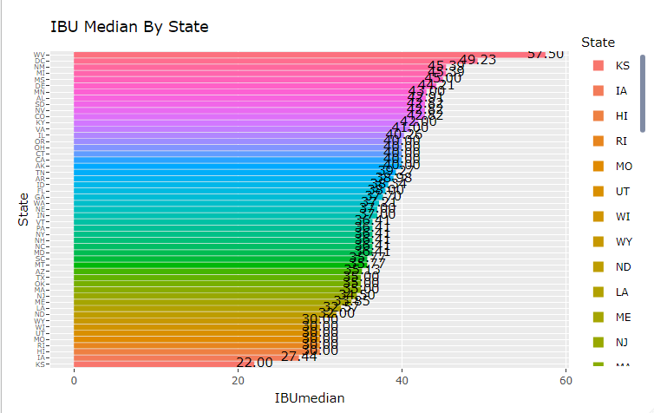
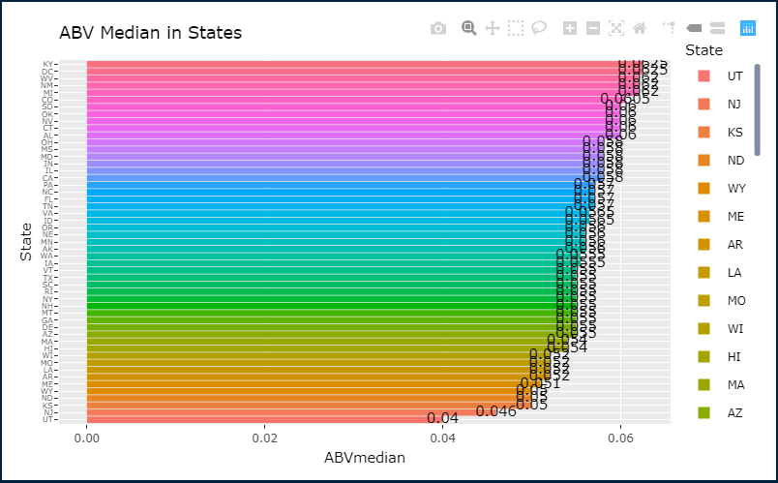
EDA - Median Analysis by State
The median IBU per state appears to change considerably between states with an overall IBU median of 37. West Virginia has the highest IBU at 57.5 and Kansas has the lowest at 22
(Fig. 2)
The median ABV per state appears fairly consistent with an overall ABV median of 0.056. Kentucky has the highest ABV at 0.062 and Utah has the lowest at 0.04
(Fig. 1)
Figure 2 IBU Median By State
Figure 1 ABV Median By State
Notes:
Questions 4 and 5

Slide 7
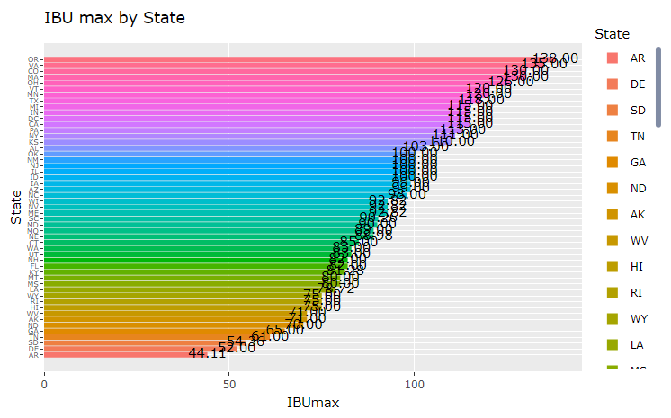
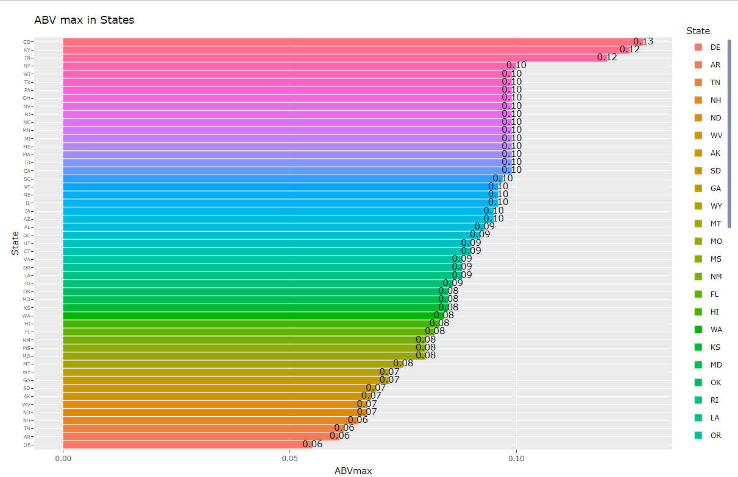
EDA – Statistical Analysis by State Maximum ABV and IBU
The maximum IBU per state appears to vary between states with an overall median of all max values at 92.82. Oregon has the highest Max IBU at 138 and Arkansas has the lowest at 44.11 (Fig. 2)
The maximum ABV per state appears to vary between states with an overall median of all max values at 0.09. Colorado has the highest Max ABV at 0.128 and Delaware has the lowest at 0.055 (Fig. 1)
Figure 2 IBU Max By State
Figure 1 ABV Max By State
Notes:
Questions 4 and 5

Slide 8
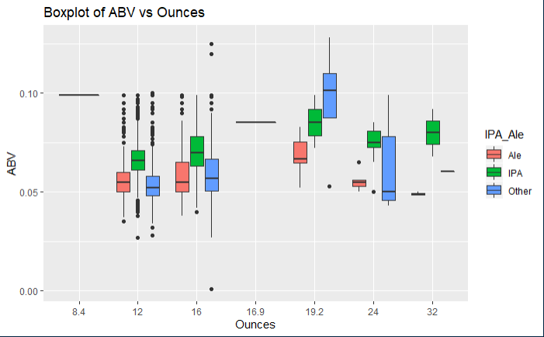
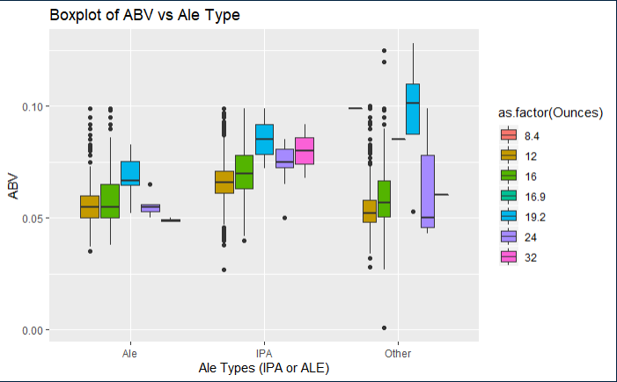
STATISTICS and DISTRIBUTION OF ABV
The ABV per size of can (oz) clearly illustrates that the IPA variety has more Alcohol By Volume than other varieties. This across all can sizes with one exception (can size=19.2). (Fig. 2)
The ABV clearly illustrates that the IPA variety has more Alcohol By Volume than other varieties. This is across all can sizes with one exception (can size=19.2) in the “other” type. (Fig. 1)
Figure 2 ABV by Size of can in Ounces
Figure 1 ABV by Ale Type
Notes:
Ask professor about the other category during ls. # 8 IPA

Slide 9
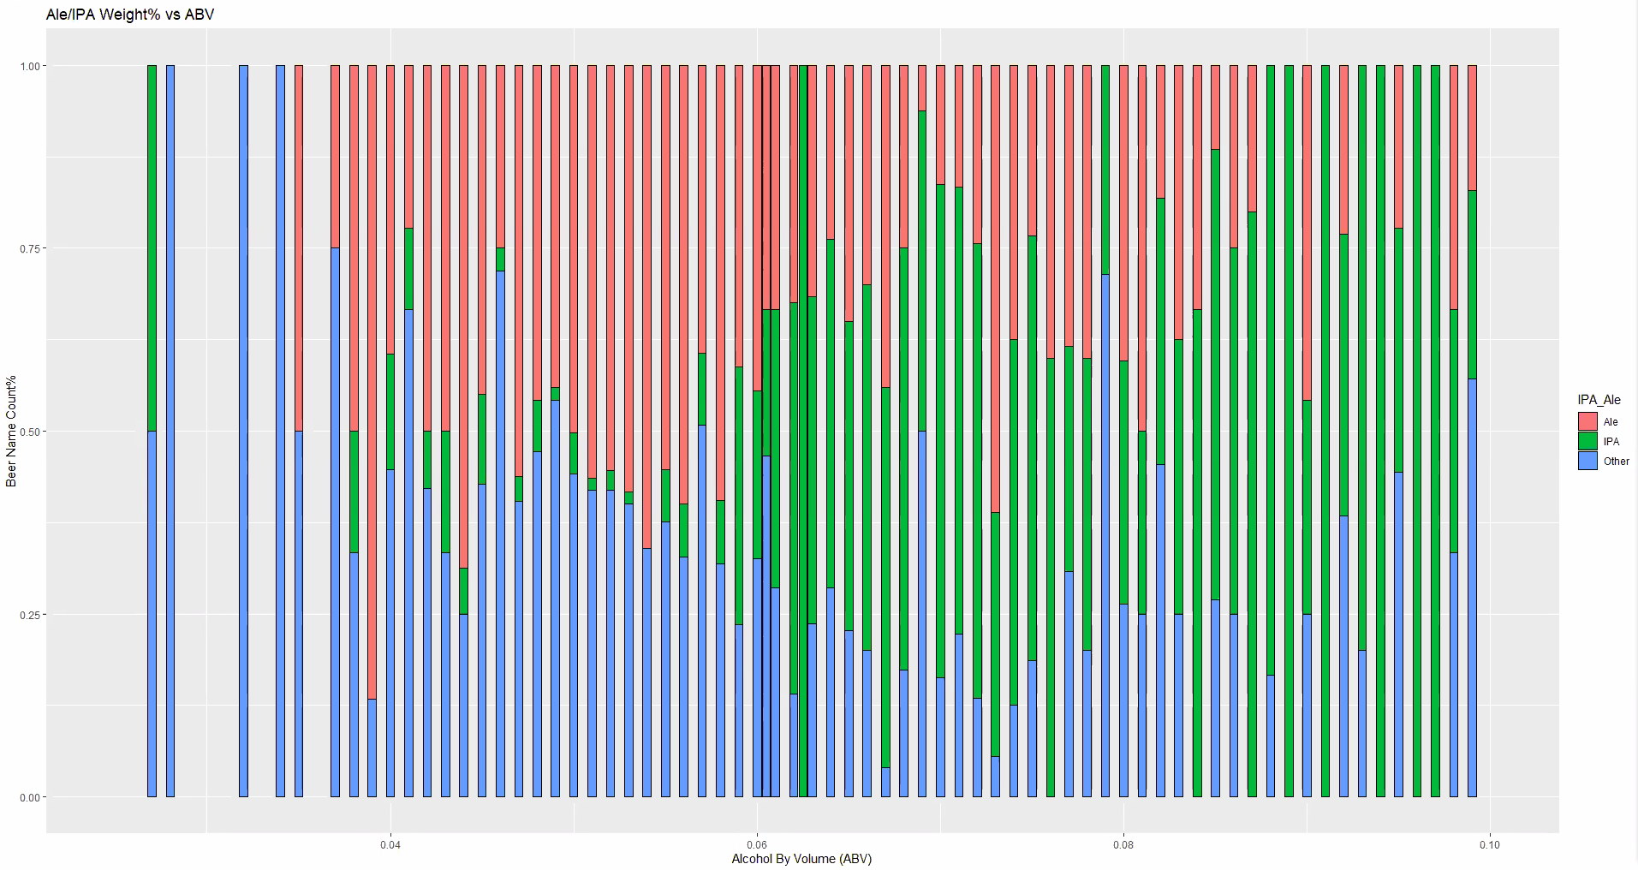
STATISTICS and DISTRIBUTION OF ABV
IPA style beer is the predominant variety when ABV exceeds 0.06. This again indicates that IPA beer tends to have higher alcohol content than other variety.

Slide 10
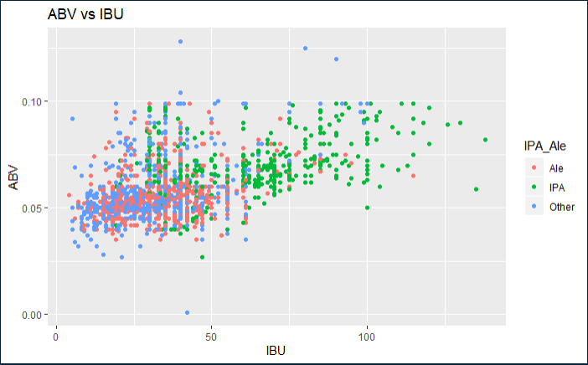
STATISTICS and DISTRIBUTION OF ABV & IBU
The point plot below illustrates what appears to a positive linear relationship between the ABB and IBU.

Slide 11
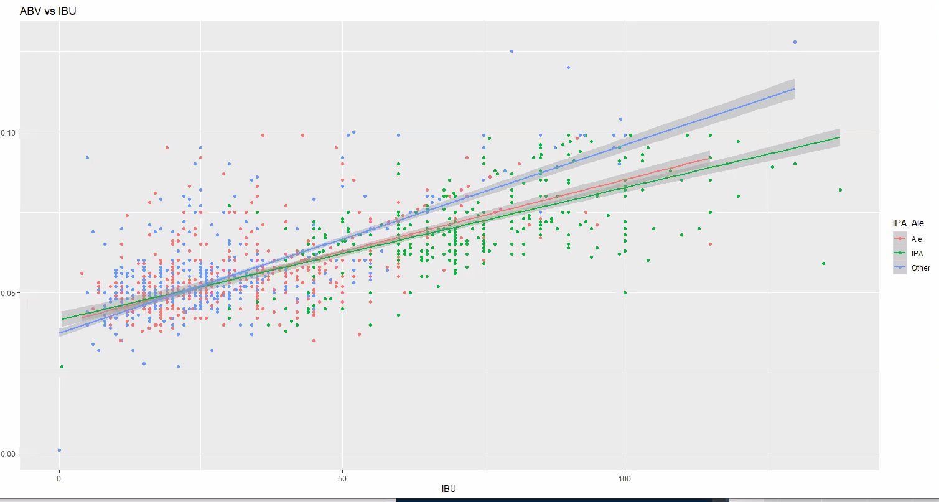
RELATIONSHIP ABV v. IBU
The addition of line trend to the point plot below confirms the presence of a positive linear relationship between the ABV and IBU.

Slide 12
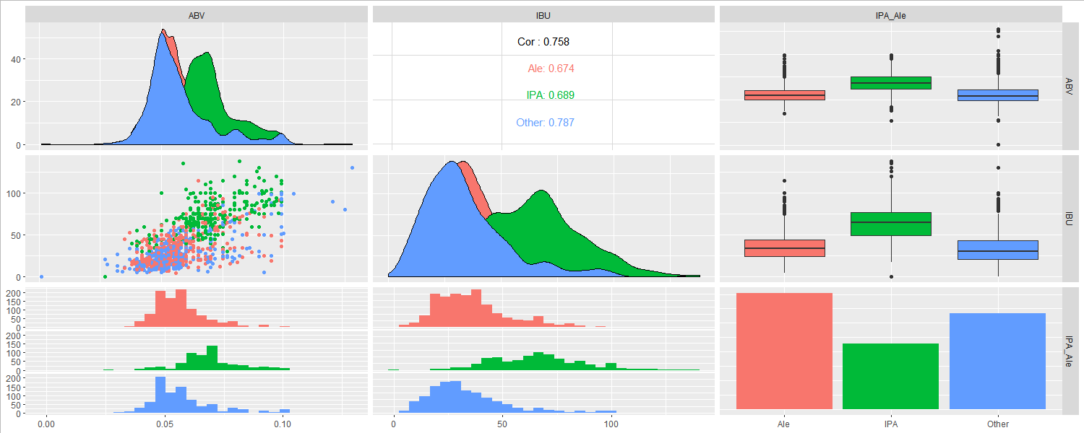
RELATIONSHIP ABV v. IBU
GGPairs Plot below shows a strong correlation between ABV and IBU across all styles of beers. The strongest correlation is in other beer style category at 0.787 followed by IPA at 0.689.

Slide 13
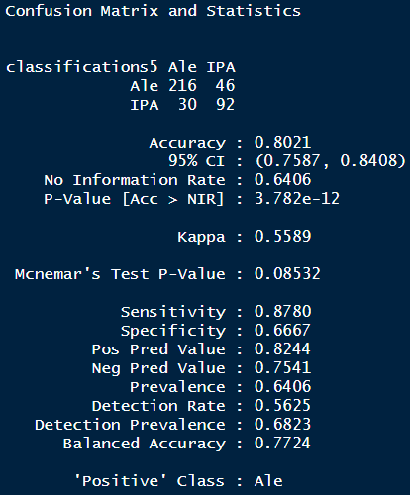
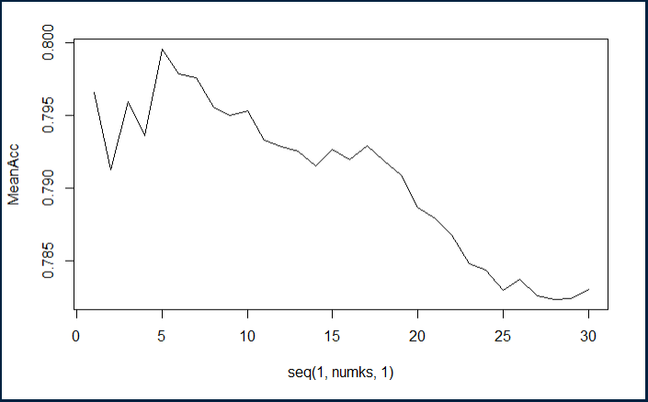
KNN CLUSTERING for IPAs vs Ale
A KNN classification model with a 75% split and 50 iteration results in an 80% (Fig. 1) classification accuracy as shown in the confusion matrix in (Fig. 1). This was achieve by trying 30 different K values resulting in K=5 as the optimal value as shown (Fig. 2).
Split % = 75%
Iterations = 50
Num of ks = 30
Optimal K = 5
Figure 2 Optimal K value based on 75% training split
Figure 1 Confusion Matrix

Slide 14
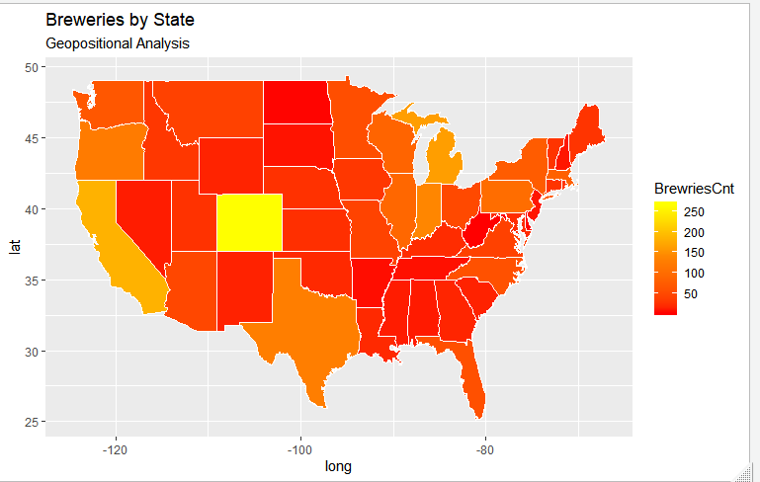
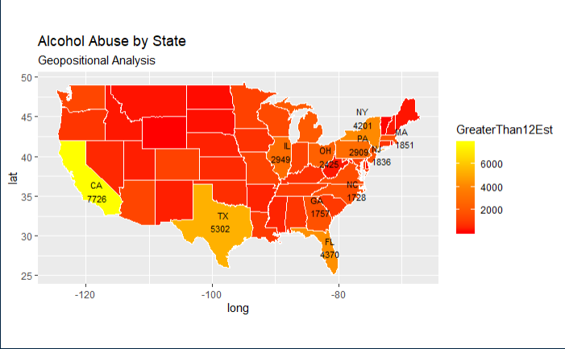
Additional Analysis
Based on visual Geo-positional analysis of Breweries presence by state (count) and Alcohol abuse by State there appears to be a correlation. This may justify further investigation.
Figure 1 Breweries Geo-positional Map
Figure 2 Alcohol Abuse by State Geo-positional Map

Slide 15
Backup
Notes:
Question 2

Slide 16
EDA – ABV & IBU distribution Merged Breweries and Beers DF
The Following is a sample data showing the First and last six records of the merged data set
Brewery_id Beer_name Beer_ID ABV IBU Style Ounces Brewery_name
1 1 Get Together 2692 0.045 50 American IPA 16 NorthGate Brewing
2 1 Maggie's Leap 2691 0.049 26 Milk / Sweet Stout 16 NorthGate Brewing
3 1 Wall's End 2690 0.048 19 English Brown Ale 16 NorthGate Brewing
4 1 Pumpion 2689 0.060 38 Pumpkin Ale 16 NorthGate Brewing
5 1 Stronghold 2688 0.060 25 American Porter 16 NorthGate Brewing
6 1 Parapet ESB 2687 0.056 47 Extra Special / Strong Bitter (ESB) 16 NorthGate Brewing
City abb
1 Minneapolis MN
2 Minneapolis MN
3 Minneapolis MN
4 Minneapolis MN
5 Minneapolis MN
6 Minneapolis MN
Brewery_id Beer_name Beer_ID ABV IBU Style Ounces
2405 556 Pilsner Ukiah 98 0.055 42.71 German Pilsener 12
2406 557 Heinnieweisse Weissebier 52 0.049 42.71 Hefeweizen 12
2407 557 Snapperhead IPA 51 0.068 42.71 American IPA 12
2408 557 Moo Thunder Stout 50 0.049 42.71 Milk / Sweet Stout 12
2409 557 Porkslap Pale Ale 49 0.043 42.71 American Pale Ale (APA) 12
2410 558 Urban Wilderness Pale Ale 30 0.049 42.71 English Pale Ale 12
Brewery_name City abb
2405 Ukiah Brewing Company Ukiah CA
2406 Butternuts Beer and Ale Garrattsville NY
2407 Butternuts Beer and Ale Garrattsville NY
2408 Butternuts Beer and Ale Garrattsville NY
2409 Butternuts Beer and Ale Garrattsville NY
2410 Sleeping Lady Brewing Company Anchorage AK
Notes:
Question 2

